Slide 1
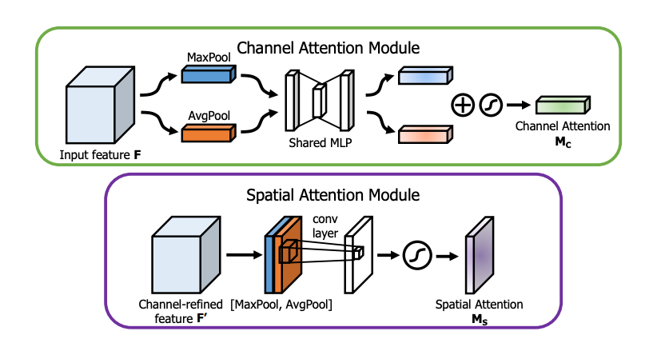
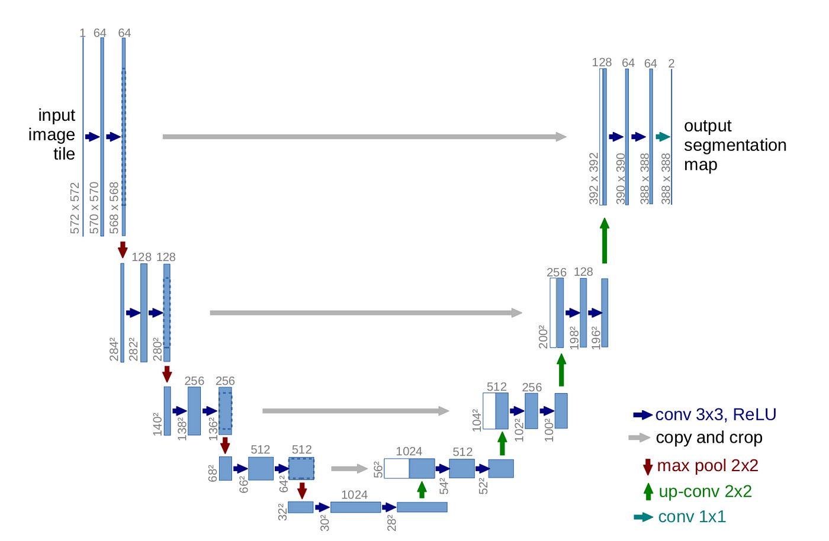
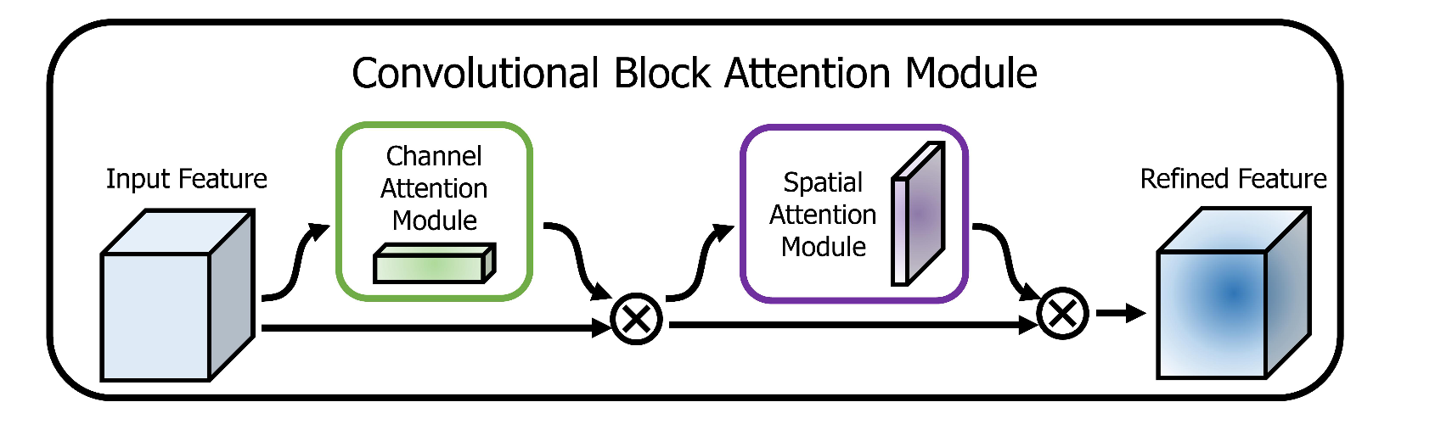
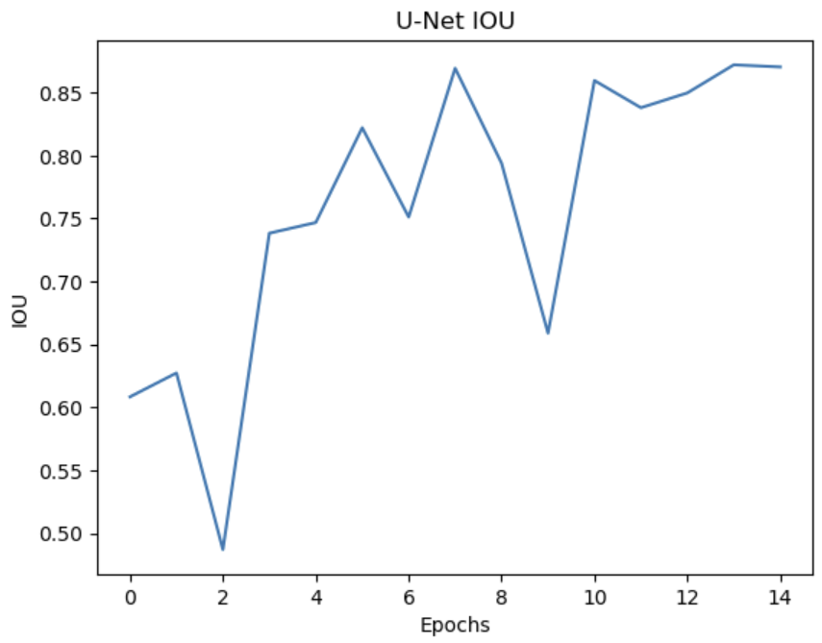
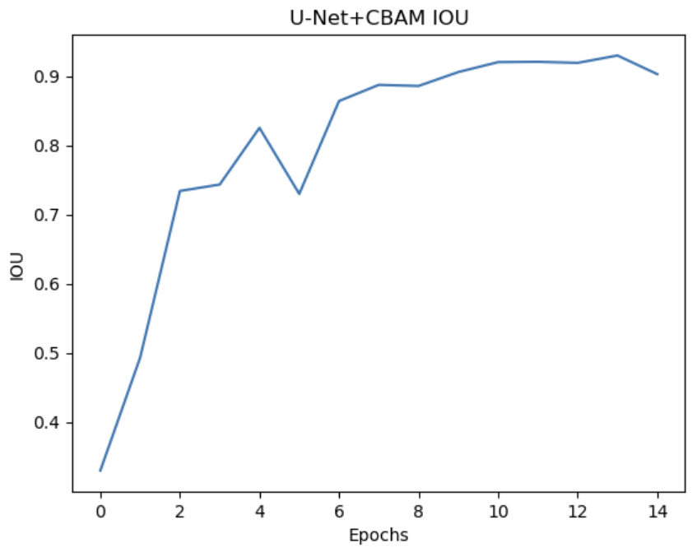
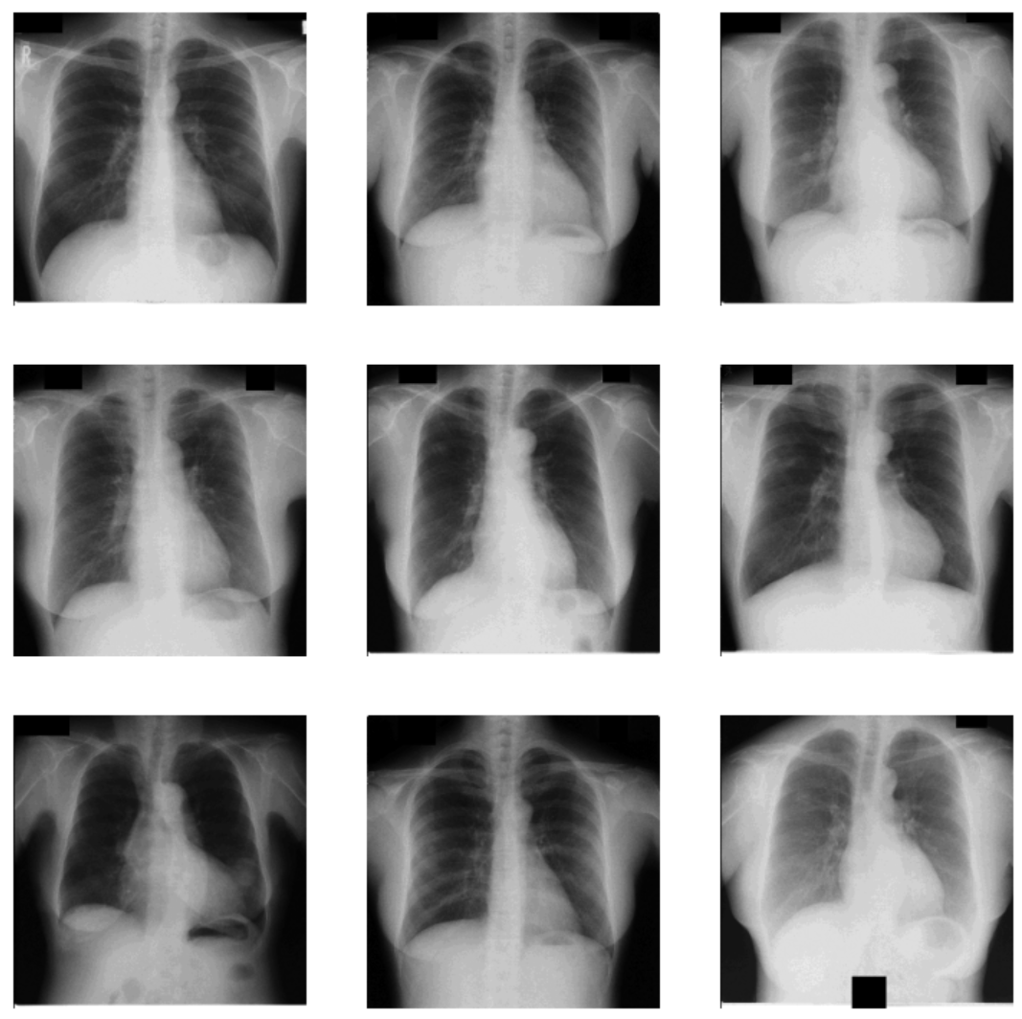
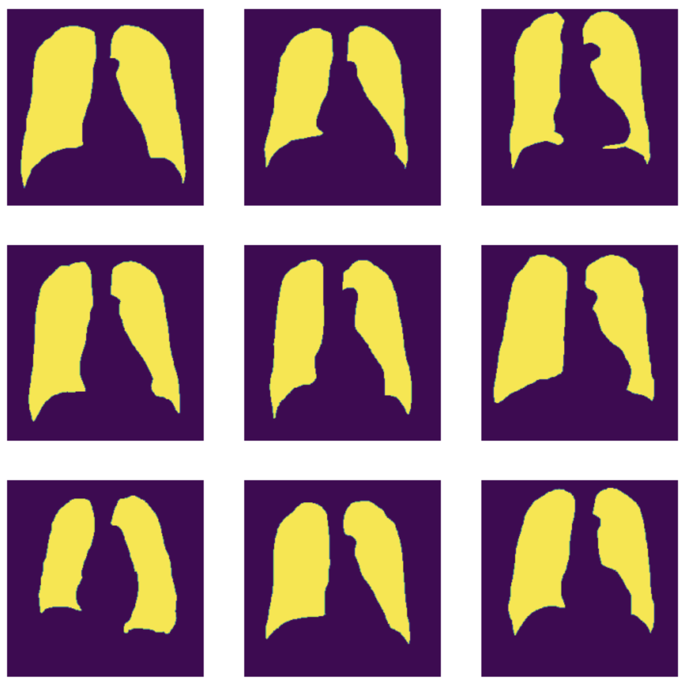
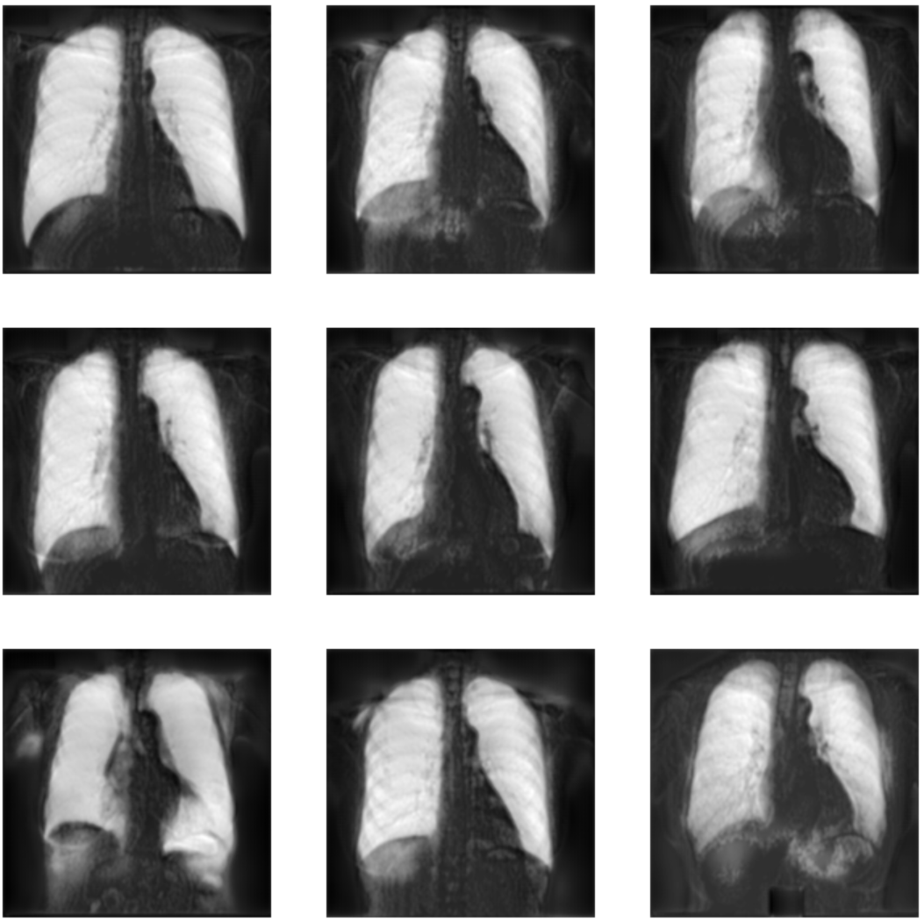
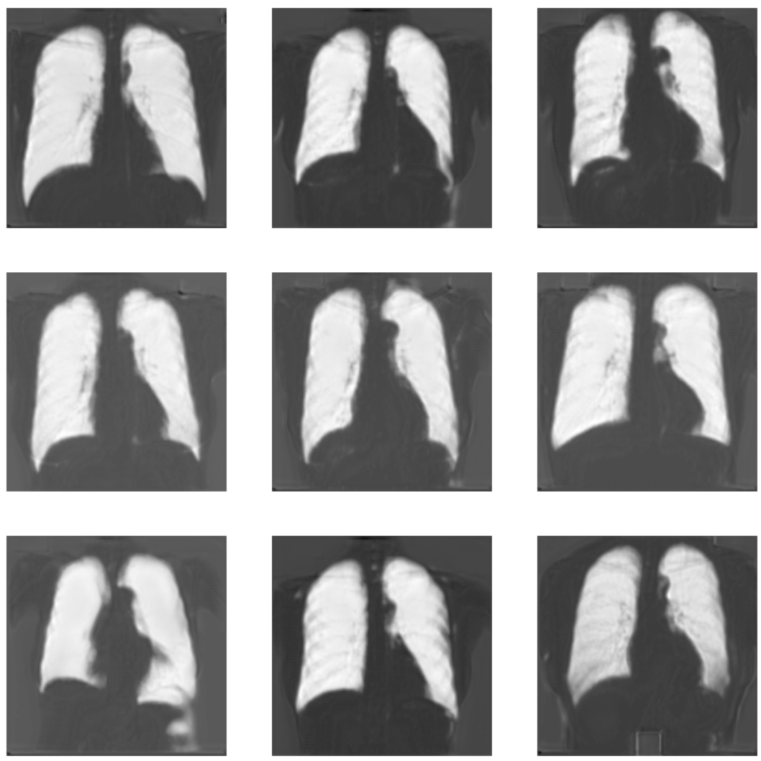
SEGMENTATION using U-Net + CBAM on Chest X-rays
Nitin Reddy Yarava, Sonny Mousavi
Arizona State University
Architecture
PLOTS
Abstract
The integration of attention mechanisms within convolutional neural networks (CNNs) has shown potential to enhance image segmentation tasks in medical imaging analysis. This study introduces a modified U-Net architecture augmented with a Convolutional Block Attention Module (CBAM), aimed at improving segmentation results on chest X-ray images. We compared the performance of the traditional U-Net model against our CBAM-enhanced U-Net using IOU metric. The results indicate that the inclusion of the CBAM significantly improves the model’s ability to focus on relevant features within the X-rays, thereby enhancing the segmentation quality. This work demonstrates the effectiveness of incorporating attention mechanisms in medical image analysis and provides insights into their practical benefits and applicability in enhancing diagnostic procedures.
Convolutional Block Attention Module (CBAM)
Channel Attention + Spatial Attention
U-Net
Max IOU: 87.2
Max IOU: 92.9
Introduction
Results
Experiment Details
Image segmentation is pivotal in medical image analysis, facilitating the delineation of anatomical structures and potential pathologies for more accurate diagnosis and treatment planning. Among the various deep learning models employed for this purpose, U-Net is widely recognized for its efficient architecture tailored for medical image segmentation. However, U-Net can sometimes struggle with the varying intensities and complex patterns present in medical images such as chest X-rays. To address these challenges, attention mechanisms like the Convolutional Block Attention Module (CBAM) are integrated to refine feature representation and focus the model's learning on salient regions of the image.
DATASET: MiniJSRT, Training – 50 ,Testing – 10 learning rate – 0.001
Batch size – 6
Optimizer – Adam
Loss – BCEWithLogits
Epochs - 15
This study explores the adaptation of U-Net through the integration of CBAM, aiming to enhance the model's sensitivity and specificity in segmenting chest X-rays. The CBAM is designed to sequentially infer attention maps along both channel and spatial dimensions, which helps in emphasizing important features while suppressing less useful ones. We hypothesized that this attention-enhanced architecture would outperform the conventional U-Net in terms of segmentation accuracy and detail. To test this hypothesis, we conducted an experiment comparing the modified U-Net with the original version, assessing their performance on a dataset of chest X-rays. The findings from this comparative analysis aim to provide valuable insights into the benefits of attention mechanisms in medical image segmentation and their potential to improve diagnostic imaging workflows.
Inputs
Ground Truth
Conclusion
The integration of the Convolutional Block Attention Module (CBAM) into the U-Net architecture has shown some improvements in the segmentation of chest X-rays. Our comparative analysis, conducted on the MiniJSRT dataset with a training subset of 50 images and a testing subset of 10 images, revealed that the U-Net enhanced with CBAM achieved a maximum Intersection over Union (IoU) of 92.9%, surpassing the traditional U-Net's performance of 87.2%. These results are underpinned by hyperparameters optimized for this task, including a learning rate of 0.001, a batch size of 6, the use of the Adam optimizer, BCEWithLogits loss, and a training duration of 15 epochs. Visualization of the segmentation predictions further illustrates the advantage of the CBAM-enhanced U-Net, showing more refined segmentations with less noise compared to the baseline model. This enhancement can be attributed to the CBAM's ability to focus the network's attention on salient features, which is critical in achieving higher precision in medical imaging. Overall, our findings confirm that attention mechanisms like CBAM can substantially elevate the performance of segmentation models in medical imaging.
U-Net
U-Net + CBAM

